Slide 1

Distributed Systems
Unit 4 COMMUNICATION
Ling ZHOU
School of Computer Science and Engineering
College of Software Engineering,
Southeast University, Nanjing
ling.zhou@seu.edu.cn

Slide 2

Unit 4 – Communication: Outline
Fundamentals
Layered Protocols
Types of Communication
Remote Procedure Call (RPC)
Message-Oriented Communication
Stream-Oriented Communication
Multicast Communication
Summary
Four high-level middleware communication service
Notes:
Interprocess communication is at the heart of all distributed systems. It makes
no sense to study distributed systems without carefully examining the ways that
processes on different machines can exchange information. Communication in
distributed systems is always based on low-level message passing as offered by
the underlying network. Expressing communication through message passing is
harder than using primitives based on shared memory, as available for nondistributed
platforms. Modem distributed systems often consist of thousands or even
millions of processes scattered across a network with unreliable communication
such as the Internet.
In this chapter, we start by discussing the rules that communicating processes
must adhere to, known as protocols, and concentrate on structuring those protocols
in the form of layers. We then look at three widely-used models for communication:
Remote Procedure Call (RPC), Message-Oriented Middleware (MOM),
and data streaming. We also discuss the general problem of sending data to multiple
receivers, called multicasting.

Slide 3
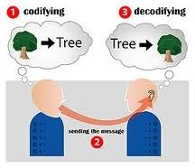
Fundamentals
Due to the absence of shared memory, all communication in DS is based on sending and receiving (low level) messages
Expressing communication through message passing is harder than using primitives based on shared memory, as available for non-distributed platforms.
When process A wants to communicate with process B over the network, agreements between A and B are needed at a variety of levels
varying from the low-level details of bit transmission to the high-level details of how information is to be expressed.
Notes:
Before we start our discussion on communication in distributed systems, we
first recapitulate some of the fundamental issues related to communication.

Slide 4

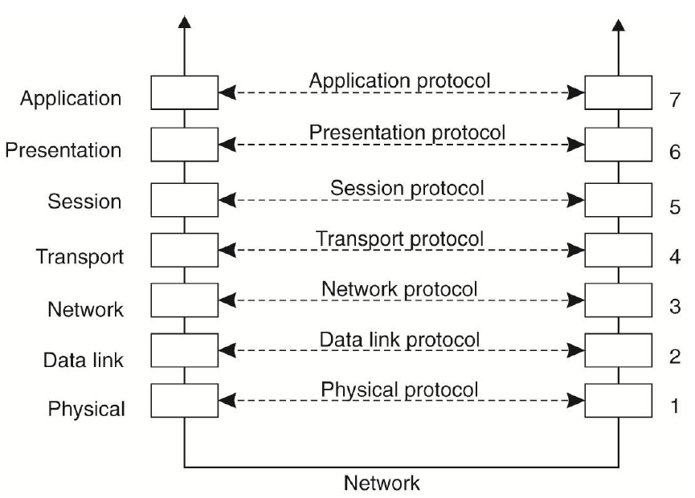
Layered Protocols (1)
Machine 1
Machine 2
Why Layering?
Explicit structure allows identification, relationship of complex system’s pieces
Modularization eases maintenance, updating of system
Functionality may be duplicated.
One layer may need information present only in another layer (violates the goal of separation of layers)
NOTE:
Open System Interconnection Reference Model (OSI Model)
Each layer provides an interface to the one above it
OSI model protocols were never widely used and are essentially dead now

Slide 5
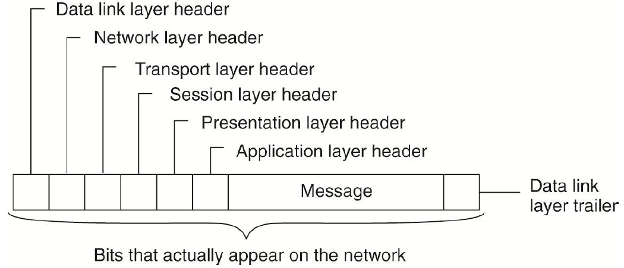

Layered Protocols (2)
Types of protocols
Connection oriented protocols
Establish a connection
Negotiate the protocol
Release the connection
Connectionless protocols
No setup in advance is needed
The information in the layer n header is used for the layer n protocol.
Each layer has its own protocol that can be changed independently of the other one
The independence makes layered protocols attractive

Slide 6
Internet protocol stack
application: supporting network applications
FTP, SMTP, HTTP
transport: process-process data transfer
TCP, UDP
network: routing of datagrams from source to destination
IP, routing protocols
link: data transfer between neighboring network elements including error correction
PPP, Ethernet
physical: bits “on the wire”
application
transport
network
link
physical
Lower-level protocols
Observation: For many distributed systems, the lowest-level interface is that of the layer.
network

Slide 7
Internet Protocol Stack: Encapsulation
source
message
M
application
transport
network
link
physical
segment
H_{t}
M
H_{t}
datagram
H_{n}
H_{t}
M
frame
H_{l}
H_{n}
H_{t}
M
T_{l}
link
physical
switch
destination
H_{n}
H_{t}
M
network
link
physical
M
application
transport
network
link
physical
H_{l}
H_{n}
H_{t}
M
H_{n}
H_{t}
M
H_{t}
M
H_{n}
H_{t}
M
H_{l}
H_{n}
H_{t}
M
router
T_{l}

Slide 8
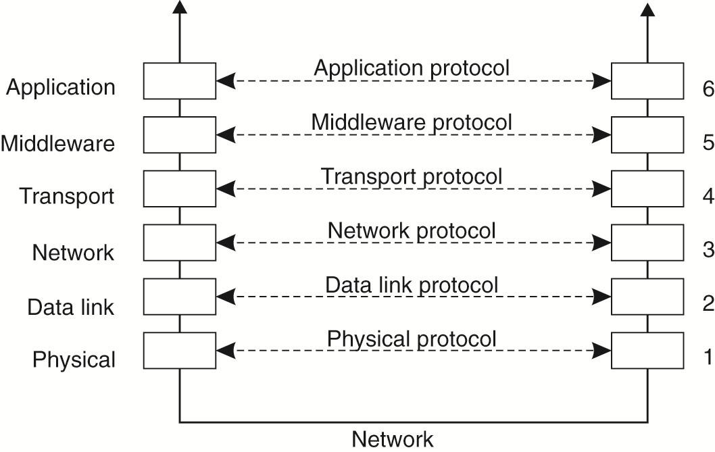
Middleware Protocols
Middleware is an application that logically lives (mostly) in the application layer, which contains many more general-purpose (application-independent) protocols, such as
Authentication/authorization protocols, distributed commit protocols, distributed locking protocols
A rich set of communication protocols
Support high-level communication services
Could belong in the transport layer

Slide 9
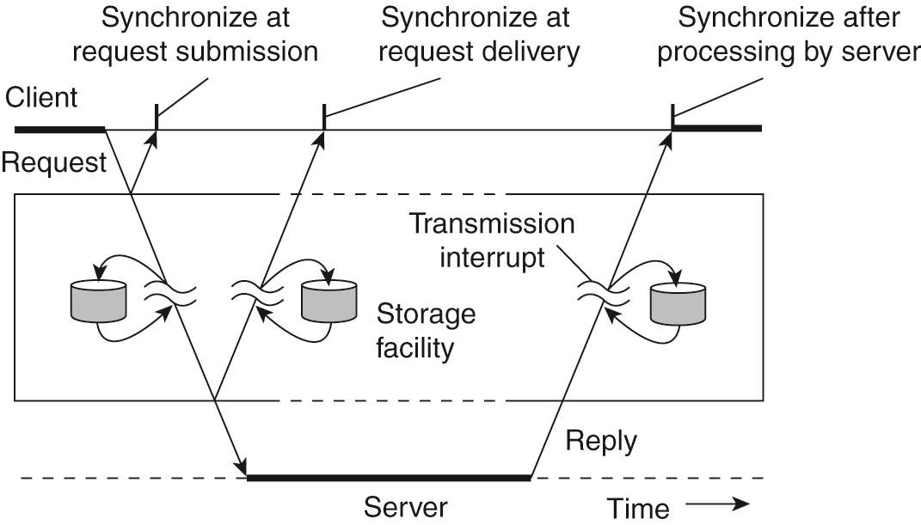
Types of Communication
Viewing middleware as an intermediate (distributed) service in application-level communication
Distinguish various alternatives in communication that middleware can offer to applications:
Transient versus persistent communication
Asynchronous versus synchronous communication
Discrete and streaming communication
Notes:
To understand the various alternatives in communication that middleware can
offer to applications, we view the middleware as an additional service in client-server
computing, as shown in the Figure.

Slide 10
Persistent or Transient
Transient communication: Comm. server discards message when it cannot be delivered at the next server, or at the receiver.
Persistent communication: A message is stored at a communication server as long as it takes to deliver it.
The middleware will store the message at one or several of the storage facilities

Slide 11
Asynchronous and Synchronous
Three points where synchronization can take place
Asynchronous communication: a sender continues immediately after it has submitted its message for transmission
Synchronous communication: the sender is blocked until its request is known to be accepted.

Slide 12

Discrete and streaming communication
Discrete communication: such as the parties communicate by messages, each message forming a complete unit of information
Streaming communication involves sending multiple messages, one after the other.

Slide 13
Combinations of persistence and synchronization
Popular combination: persistence + synchronization at request submission (i.e., persistent asynchronous communication)
A common scheme for many message-queuing systems
Widely used model: transient + synchronization after the request has been fully processed
Client and server have to be active at time of communication
Client issues request and blocks until it receives reply
Server essentially waits only for incoming requests, and subsequently processes them
E.g., RPC
Drawbacks synchronous communication
Client cannot do any other work while waiting for reply
Failures have to be handled immediately: the client is waiting
The model may simply not be appropriate (mail, news)

Slide 14
Unit 4 – Communication: Outline
Fundamentals
Layered Protocols
Types of Communication
Remote Procedure Call (RPC)
Message-Oriented Communication
Stream-Oriented Communication
Multicast Communication
Summary
Four high-level middleware communication service

Slide 15

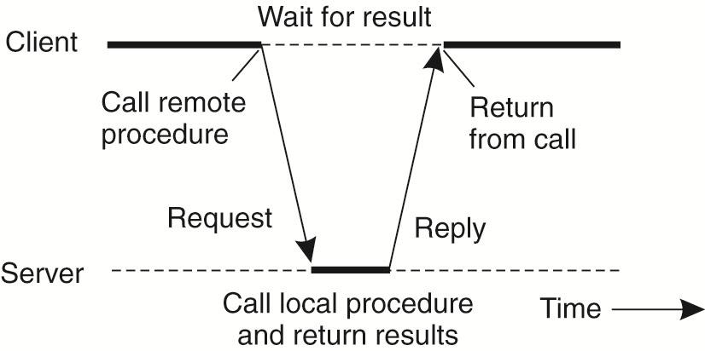
Remote Procedure Call (RPC)
An RPC aims at hiding most of the intricacies of message passing, and is ideal for C/S applications.
RPC in a nutshell was allowing programs to call procedures located on other machines.
When a process on machine A calls a procedure on machine B, the calling process on A is suspended, and execution of the called procedure takes place on B
Information can be transported from the caller to the callee in the parameters and can come back in the procedure result
No message passing at all is visible to programmer. The calling procedure should not be aware that the called procedure is executing on a different machine or vice versa.
NOTE
Subtle problems exist due to the caller and callee on different machines
RPC is still a widely-used technique as the basis of middleware and DS in general
Notes:
Remote procedure calls have been widely adopted as the basis of middleware
and distributed systems in general.
While the basic idea sounds simple and elegant, subtle problems exist. To
start with, because the calling and called procedures run on different machines,
they execute in different address spaces, which causes complications. Parameters
and results also have to be passed, which can be complicated, especially if the machines
are not identical. Finally, either or both machines can crash and each of the
possible failures causes different problems. Still, most of these can be dealt with,
and RPC is a widely-used technique that underlies many distributed systems.

Slide 16
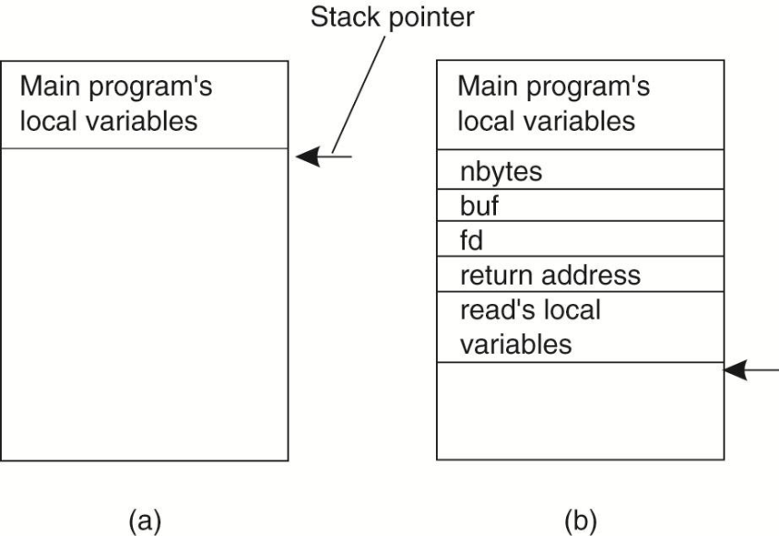
Basic RPC Operation: Conventional (local) Procedure Call
a call in C (programming lanuage)
Count = read(fd, buf, nbytes);
An integer indicating a file
integer
Call-by-value
Call-by-reference
Array of characters
Parameter passing in a local procedure call: the stack before the call to read.
The stack while the called procedure is active
Call-by-copy/restore
(not used in many languages, same effect as call-by-reference)

Slide 17
Basic RPC Operation: Client and Server Stubs
A stub in distributed computing is a piece of code used for converting parameters passed during a RPC
Stub libraries must be installed on client and server side.
A client stub is responsible for conversion of parameters used in a function call and deconversion of results passed from the server
A server stub is responsible for deconversion of parameters passed by the client and conversion of the results after the execution of the function.

Slide 18
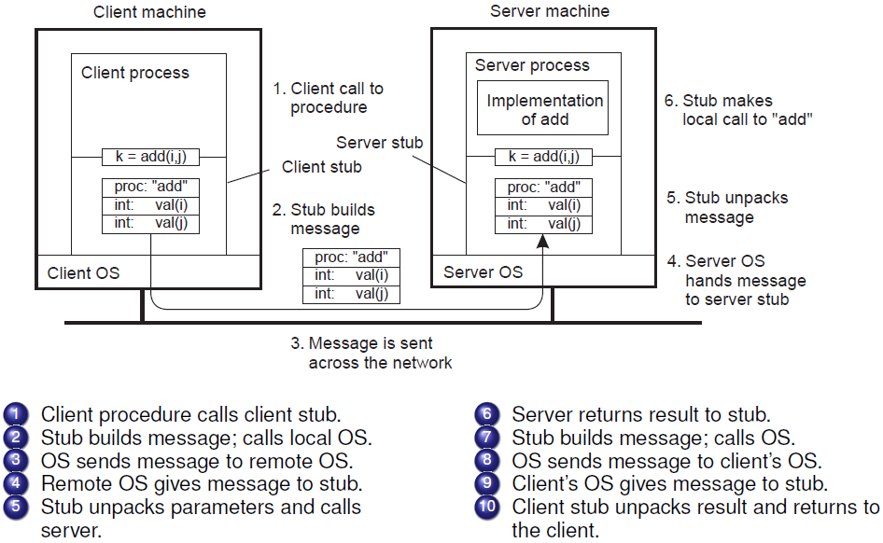
RPC steps
Server operations

Slide 19
Parameter Passing (1)
Parameter marshaling
There’s more than just wrapping parameters into a message:
Client and server machines may have different data representations (think of byte ordering)
Wrapping a parameter means transforming a value into a sequence of bytes
Client and server have to agree on the same encoding:
How are basic data values represented (integers, floats, characters)
How are complex data values represented (arrays, unions)
an address will be meaningless on another system
Client and server need to properly interpret messages, transforming them into machine-dependent representations.
Notes:
marshalling 搜索网络
英 ['mɑ:ʃəlɪŋ] 美 ['mɑʃəlɪŋ]
adj. 编组的，集结待发的;
n. 信号编集;

Slide 20
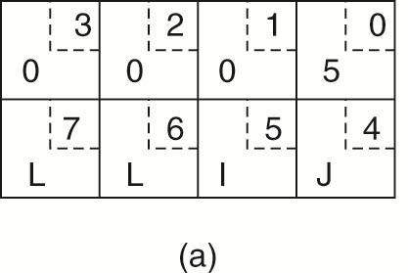
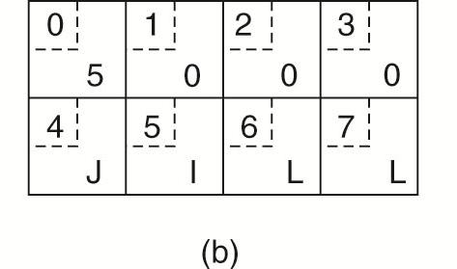
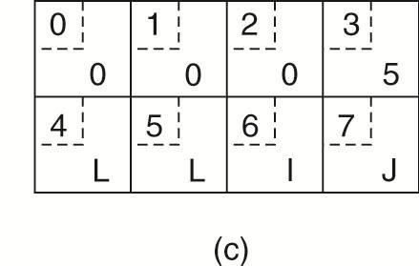
Parameter Passing (2)
little endian
big endian
5, “JILL”
5 x 2²⁴, “JILL”
5, “LIJJ”
The original message (built by a client stub) on the Intel Pentium
The message after receipt on the Sun SPARC (server stub reads)
The message after being simply inverted (incorrect approach).
The little numbers in boxes indicate the address of each byte.
Notes:
an even more annoying problem exists because some machines, such as the Intel Pentium,
number their bytes from right to left, whereas others, such as the Sun SPARC,
number them the other way. The Intel format is called little endian and the
SPARC format is called big endian, after the politicians in Gulliver's Travels
who went to war over which end of an egg to break
Since messages are transferred byte for byte (actually, bit for bit) over the network,
the first byte sent is the first byte to arrive.

Slide 21
Parameter Passing (3)
Both sides in an RPC should follow the same protocol, otherwise the RPC will not work correctly.
Once the RPC protocol has been fully defined, the client and server stubs need to be implemented.
Stubs for the same protocol but different procedures normally differ only in their interface to the applications.
Interfaces are often specified by means of an Interface Definition Language (IDL)

Slide 22
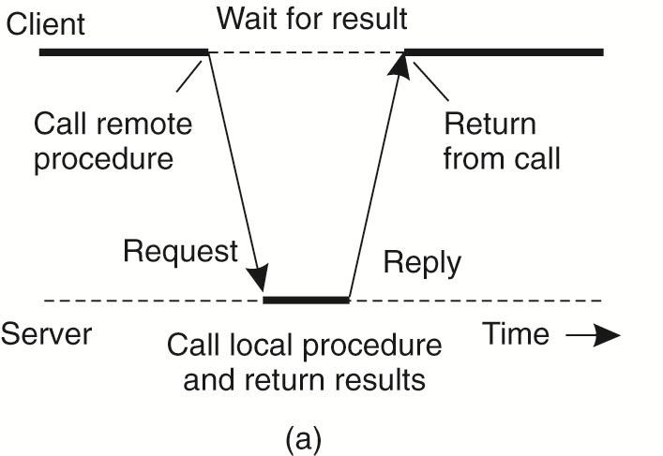
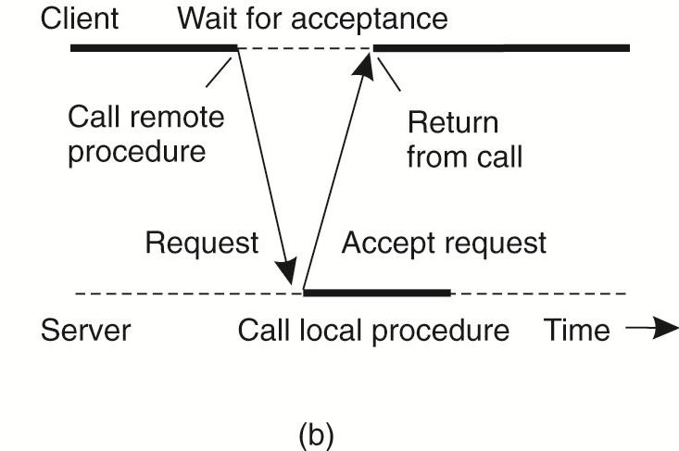
Asynchronous RPC (1)
The interaction between client and server in a traditional RPC.
The interaction using asynchronous RPC.
Asynchronous RPC: A client immediately continues once the server accepts the RPC request. The server executes the RPC request after the acknowledgement
Essence
Try to get rid of the strict request-reply behavior, but let the client
continue without waiting for an answer from the server.

Slide 23
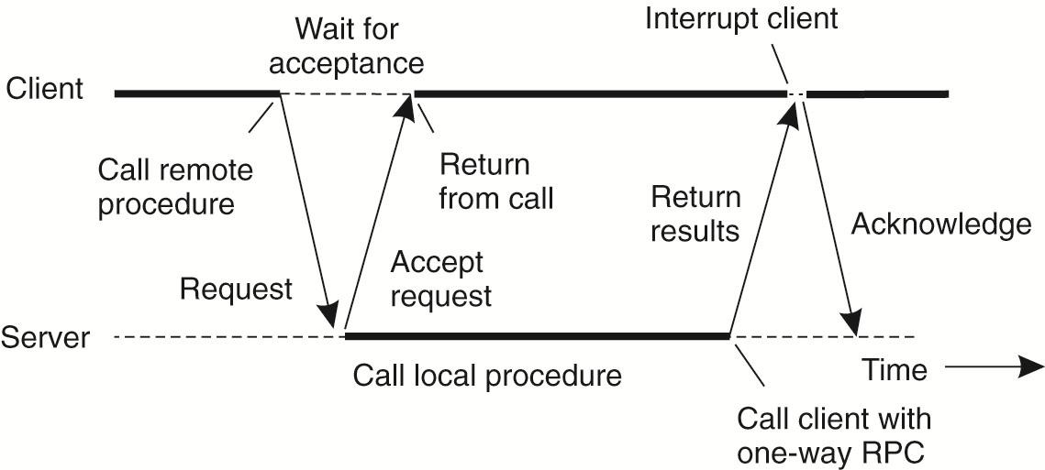
Asynchronous RPC (2)
A client and server interacting through two asynchronous RPCs.
One-way RPC
(a variant of asynchronous RPC)
The client continues executing after sending the request to the server.
Deferred asynchronous RPC: The client calls the server with a RPC request and the server immediately acknowledges it. Later the server does a callback to the client with the result.
Notes:
the client does not wait for an acknowledgment of the server's acceptance
of the request. We refer to such RPCs as one-way RPCs.
The problem with this approach is that when reliability is not guaranteed, the client cannot
know for sure whether or not its request will be processed. We return to these
matters in Chap. 8. Likewise, in the case of deferred synchronous RPC, the client
may poll the server to see whether the results are available yet instead of letting
the server calling back the client.

Slide 24
Example: Distributed Computing Environment (DCE) RPC
DCE RPC: a specific RPC system, developed by the Open Software Foundation (OSF), now called The Open Group
Not as popular as some other RPC system, notable Sun RPC but representative of other RPC system
Its specifications have been adopted in Microsoft’s base system for distributed computing, DCOM.
A true middleware system: the customer can take a collection of existing machines, add the DCE software, and then be able to run distributed applications, all without disturbing existing (nondistributed) applications.
Notes:
Remote procedure calls have been widely adopted as the basis of middleware
and distributed systems in general. In this section, we take a closer look at one
specific RPC system: the Distributed Computing Environment (DCE), which
was developed by the Open Software Foundation (OSF), now called The Open
Group.
DCOM（分布式组件对象模型,分布式组件对象模式）是一系列微软的概念和程序接口，利用这个接口，客户端程序对象能够请求来自网络中另一台计算机上的服务器程序对象。DCOM基于组件对象模型（COM），COM提供了一套允许同一台计算机上的客户端和服务器之间进行通信的接口（运行在Windows95或者其后的版本上）。
Microsoft Distributed Component Object Model（DCOM）是Component Object Model（COM）的扩展，它支持不同的两台机器上的组件间的通信，而且不论它们是运行在局域网、广域网、还是Internet上。借助DCOM你的应用程序将能够任意进行空间分布。

Slide 25
Introduction to DCE
Initially designed for UNIX, it has now been ported to all major operating systems.
Underlying programming model: C/S model
All communication between clients and servers takes place by means of RPC
DCE services
Distributed file service
Directory service
Security service
Distributed time service

Slide 26
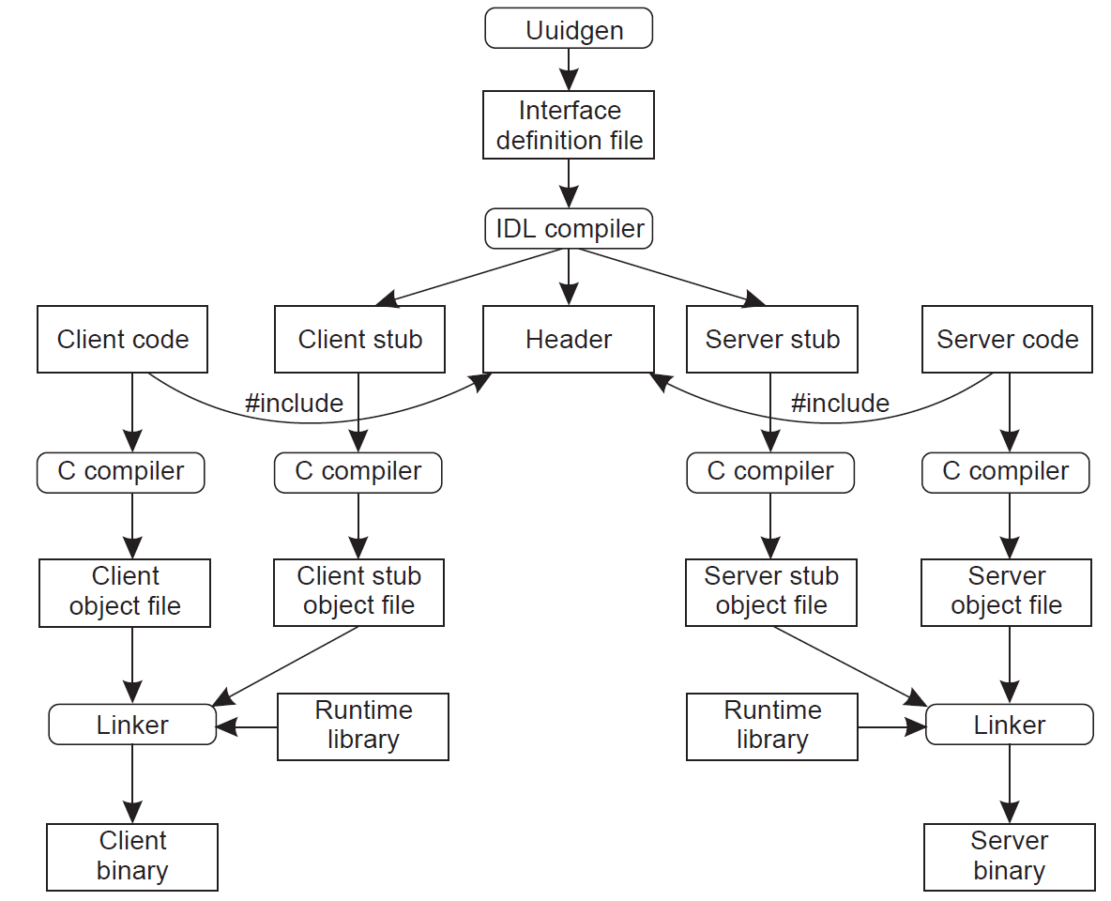
DCE RPC: Writing a Client and a Server
Step 2. Editing the IDL file, filling in the names of the remote procedures and their parameters
Step 1. Calling the uuidgen program to generate a prototype IDL file containing an globally unique interface identifier
Application writer writes the client and server code
Output of the IDL compiler
Compiled object files are linked with the runtime library to produce the executable binary files

Slide 27
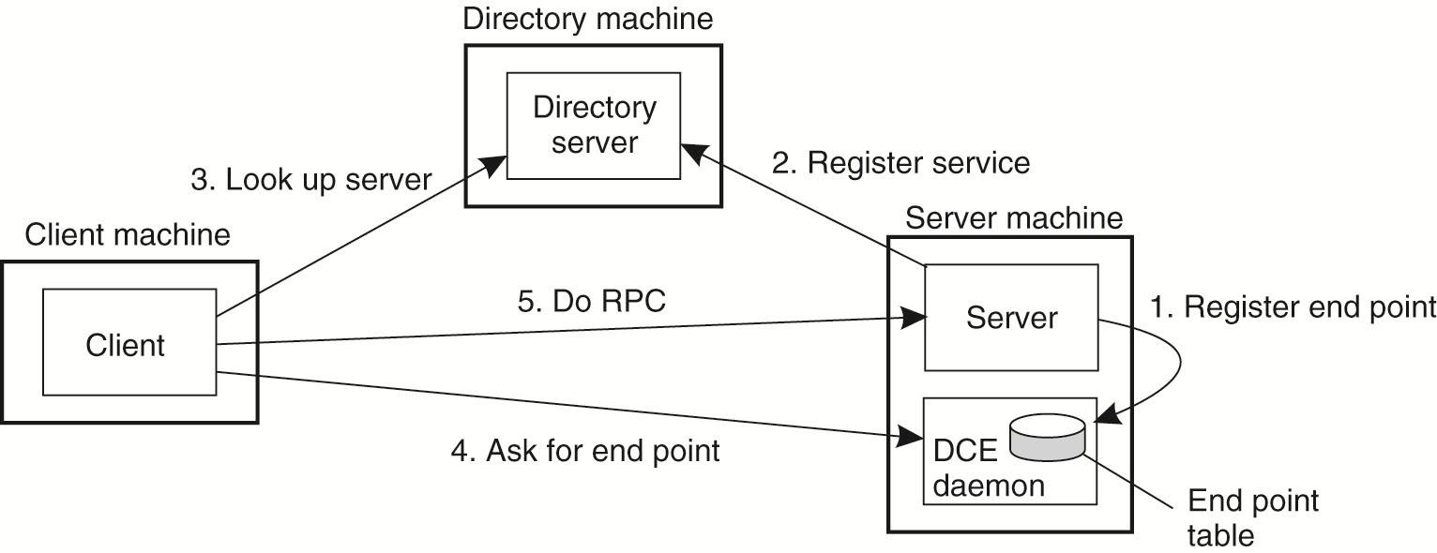
Binding a Client to a Server
Registration of a server makes it possible for a client to locate the server and bind to it
Server location is done in two steps
Locate the server’s machine
Locate the server (i.e., the correct process) on that machine
The server registers with the directory service by providing it the network address of the server’s machine and a name of the server
An end point (a.k.a. a port) is used by the server’s OS to distinguish incoming messages for different processes.

Slide 28
Unit 4 – Communication: Outline
Fundamentals
Layered Protocols
Types of Communication
Remote Procedure Call (RPC)
Message-Oriented Communication
Stream-Oriented Communication
Multicast Communication
Summary
Four high-level middleware communication service

Slide 29
Message-Oriented Communication – Outline
Message-Oriented Transient Communication
Berkeley Sockets
The Message-Passing Interface (MPI)
Message-Oriented Persistent Communication
Message-Queuing Model
General Architecture of a Message-Queuing system
Message Brokers
A Note on Message-Queuing System
Notes:
Many distributed systems and applications are built directly on top of the simple
message-oriented model offered by the transport layer. To better understand
and appreciate the message-oriented systems as part of middleware solutions, we
first discuss messaging through transport-level sockets.

Slide 30
Message-Oriented Communication
RPC, enhancing access transparency, is not always appropriate.
When it cannot be assumed that the receiver is not executing at the time a request is issued, alternative communication services are needed.
The inherent synchronous nature of RPCs sometimes needs to be replaced by something else
An alternative is messaging
The low-level communication facilities of computer networks are in many ways not suitable due to their lack of distribution transparency
Better to use a high-level message-queuing model.

Slide 31
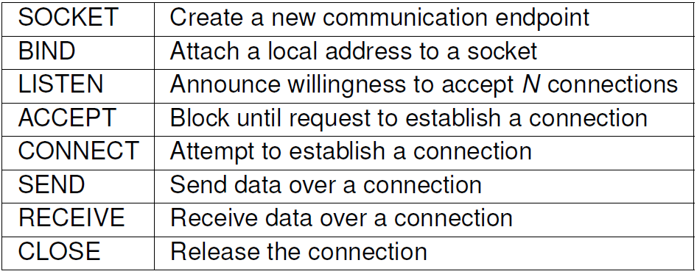
Transient messaging: sockets (1)
Messaging through transport-level sockets:
Many DS and applications are built directly on top of the simple message-oriented model offered by the transport layer.
Berkeley socket primitives for TCP/IP (introduced in the 1970s in Berkeley UNIX)

Slide 32
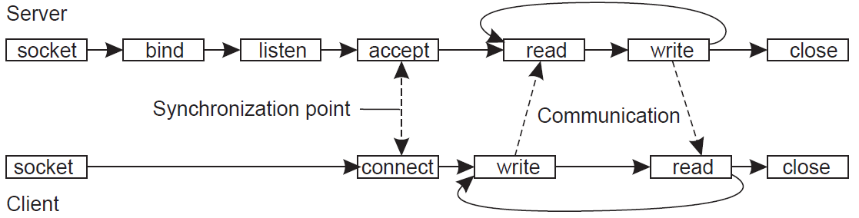
Transient messaging: sockets (2)
Connection-oriented communication pattern using sockets

Slide 33
Transient messaging: Message-Passing Interface (MPI)
With the advent of high-performance multicomputers, developers have been looking for message-oriented primitives
Sockets were deemed insufficient for two reasons
Sockets were at the wrong level of abstraction by supporting only simple send and receive primitives
Sockets had been designed to communicate across networks using general-purpose protocol stacks such as TCP/IP (not suitable for the proprietary protocols developed for high-speed networks, e.g., server clusters)
Result: most interconnection networks and high-performance multicomputers were shipped with proprietary (mutually incompatible) communication libraries  portability problem
Notes:
multicomputer-- A computer made up of several computers. The term generally refers to an architecture in which each processor has its own memory rather than multiple processors with a shared memory. Something similar to parallel computing.
Distributed computing deals with hardware and software systems containing more than one processing element or storage element, concurrent processes, or multiple programs, running under a loosely or tightly controlled regime.
A multicomputer may be considered to be either a loosely coupled NUMA computer or a tightly coupled cluster. Multicomputers are commonly used when strong computer power is required in an environment with restricted physical space or electrical power.
Common suppliers include Mercury Computer Systems, CSPI, and SKY Computers.
Common uses include 3D medical imaging devices and mobile radar.
http://answers.yahoo.com/question/index?qid=20090116034532AAZliLm

Slide 34
MPI (continue)
The need to be hardware and platform independent eventually led to the definition of a standard for message passing, i.e., Message-Passing Interface (MPI)
Designed for parallel applications and tailored to transient communication
Makes direct use of the underlying network
Assumptions:
Assumes that serious failures (e.g., process crashes or network partitions) are fatal and do not require automatic recovery.
Assumes communication takes place within a known group of processes.
A (groupID, processID) pair uniquely identifies the source or destination of a message and is used instead of a transport-level address.
There may be several, possibly overlapping groups of processes involved in a computation and that are all executing at the same time.

Slide 35
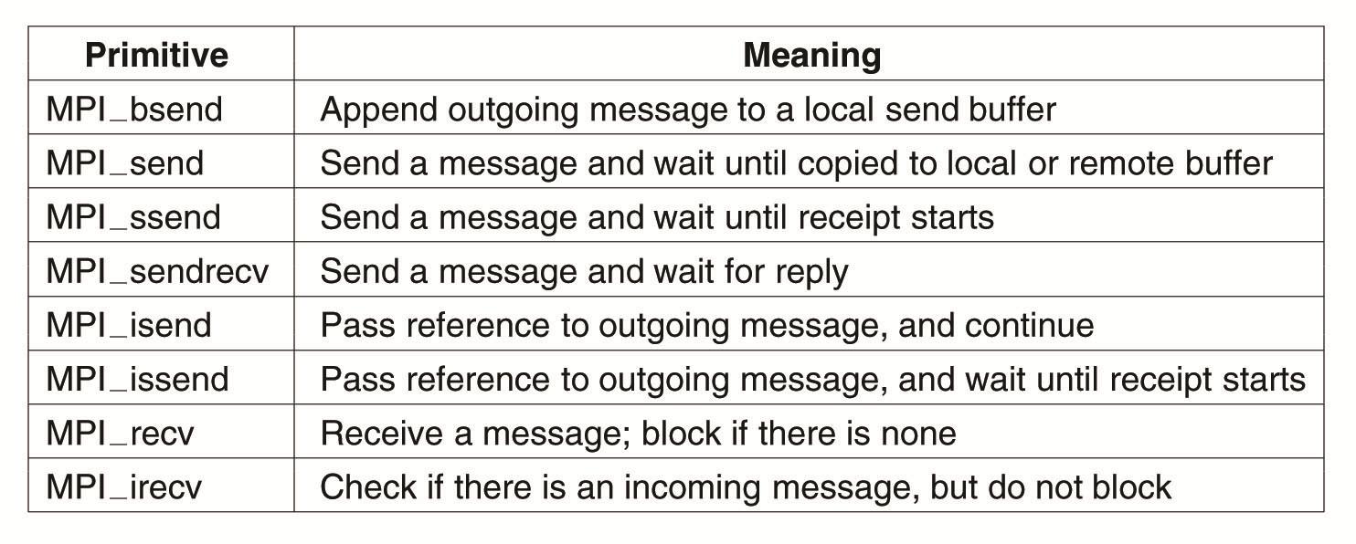
Some MPI primitives
synchronous
Asynchronous communication

Slide 36
Message-Oriented Persistent Communication
Message-queuing systems / Message-Oriented Middleware (MOM): provide extensive support for persistent asynchronous communication
Essence: the systems offer intermediate-term storage capacity for messages, without requiring either the sender or receiver to be active during message transmission.
Important difference with Berkeley sockets and MPI
Message-queuing systems are typically targeted to support message transfers that are allowed to take minutes instead of seconds or milliseconds.

Slide 37
Message-Queuing Model (1)
Basic idea: applications communicate by inserting messages in specific queues. These messages are forwarded over a series of communication servers and are eventually delivered to the destination.
In practice, most communication servers are directly connected to each other, i.e., a message is generally transferred directly to a destination server.
In principle, each application has its own private queue to which other applications can send messages.
A queue can be read only by its associated application, but it is also possible for multiple applications to share a single queue.

Slide 38
Message-Queuing Model (2)
The sender and receiver can execute completely independently of each other.
A sender is generally given only the guarantees that its message will eventually be inserted in the recipient’s queue.
No guarantees are given about when, or even if the message will actually be read, which is completely determined by the behavior of the recipient.
Once a message has been deposited in a queue, it will remain there until it is removed, irrespectively of whether its sender or receiver is executing.

Slide 39
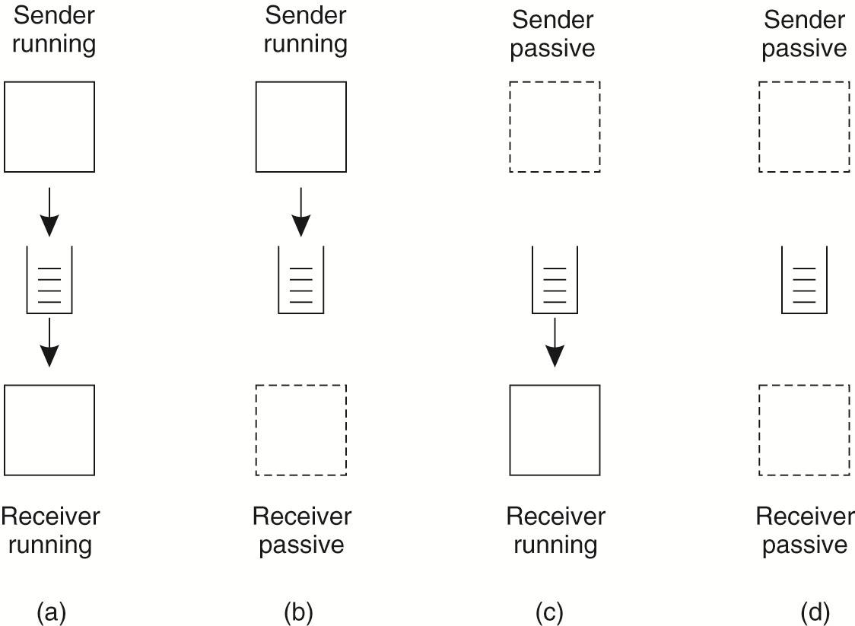
Message-Queuing Model (3)
Four combinations for loosely-coupled communications using queues
Passive: a state in which message delivery is not possible.
(b) Sender can send message
(d) The system is storing messages
(a) Message transmission
(b) Receiver can not read message
(c)
Receiver can read message

Slide 40
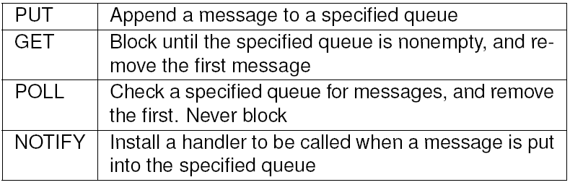
Message-Queuing Model (4)
Asynchronous persistent communication through support of middleware-level queues. Queues correspond to buffers at communication servers.
Basic interface to a queue in a message-queuing system
Nonblocking call
Blocking call
Nonblocking variant of GET
Callbacks implemented by a daemon on the receiver

Slide 41
Message-Queuing System: Basic Concepts (1)
Source queue: messages can be put only into queues that are local to the sender,
i.e., queues on the same machine, or no worse than on a machine nearby such as on the same LAN that can be efficiently reached through an RPC
Destination queue: Messages can be read only from local queues.
A message put into a queue will contain the specification of a destination queue
A message-queuing system will take care of transferring messages and maintain a mapping of queues to network locations

Slide 42
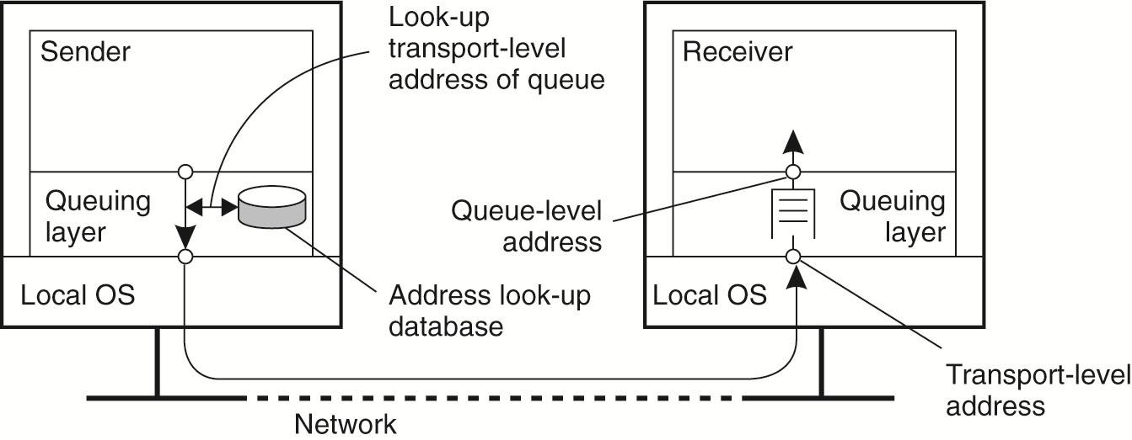
Message-Queuing System: Basic Concepts (2)
Observation: the collection of queues is distributed across multiple machines  a message-queuing system should maintain a mapping (possibly distributed database) of queues names to network locations
Analogous to the use of the DNS for e-mail in the Internet.
The relationship between queue-level addressing and transport-level addressing

Slide 43
Message-Queuing System: Queue Managers Act as Routers (1)
Queues are managed by queue managers (QM)
A normal QM acts directly with the application that is sending or receiving a message
Special QM operate as routers, or relays
Relays can be convenient:
Help build scalable message-queuing systems, especially when adopting dynamic routing schemes.
Static topology of the queuing network (each queue manager needs a copy of the queue-to-location mapping)  easily lead to network-management problems in large-scale queuing systems.
Allow for secondary processing of messages (e.g., message brokers)
Used for multicasting purposes (an incoming message is simply put into each send queue)

Slide 44
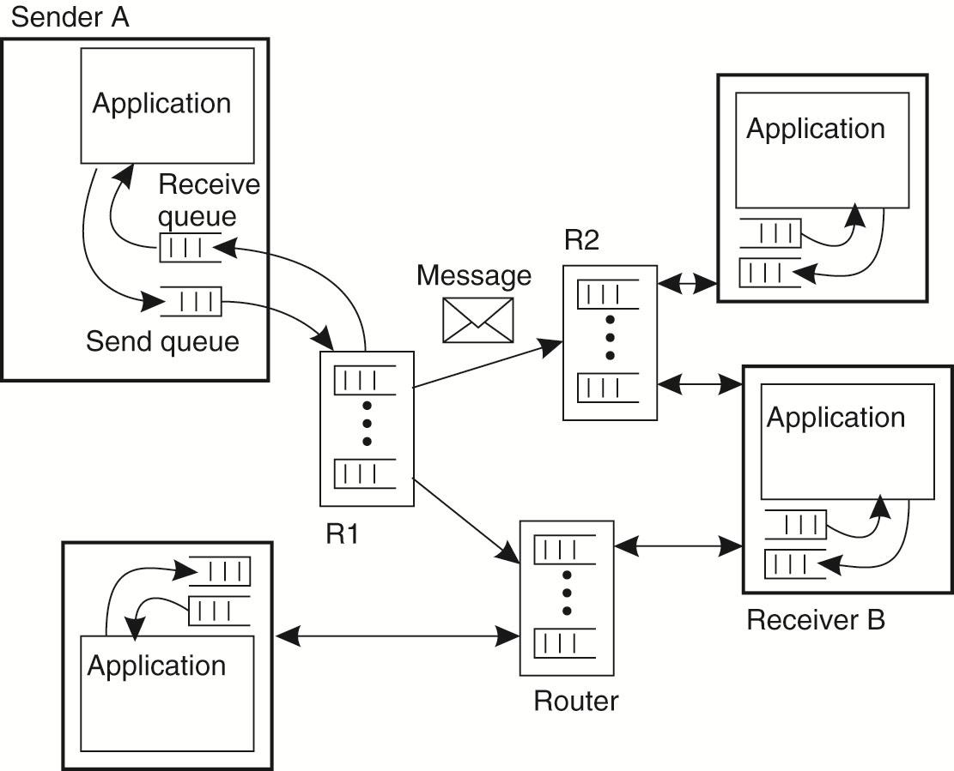
Message-Queuing System: General Architecture with Routers
Only the routers need to be updated when queues are added or removed, while every other QM has to know only where the nearest router is.
Normal queue manager
Messages in local queue are first transferred to the nearest router R1
R1 knows to forwards the messages in the direction of B

Slide 45
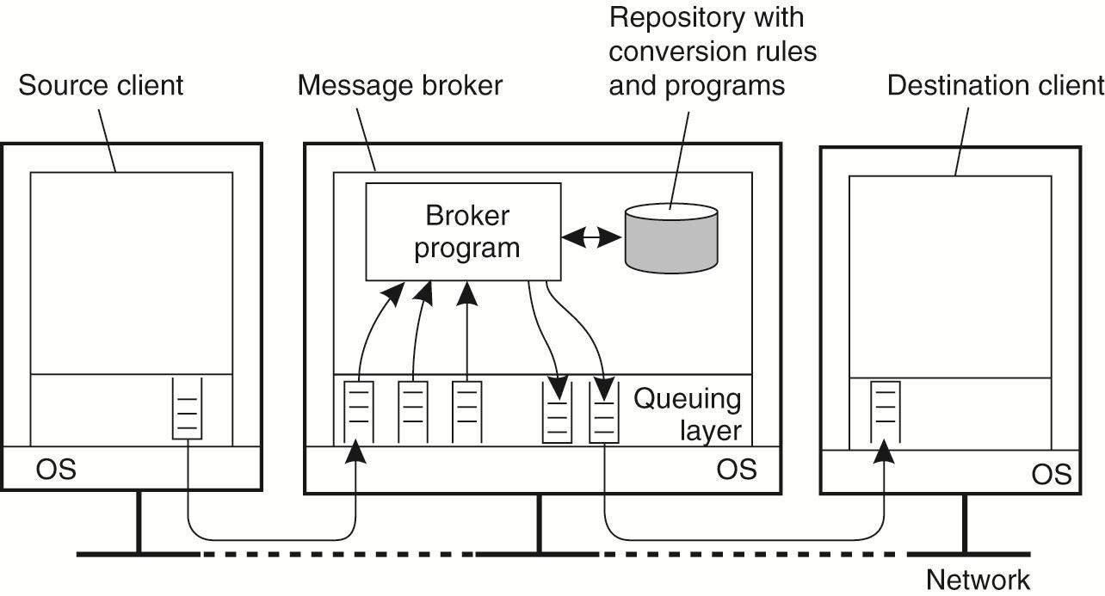
Message Brokers
Main purpose: convert incoming messages into a format that can be understood by the receiver.
Can simply act as a reformatter for messages
Act as application-level gateways (handling the conversion between two different database applications)
Generally not considered to be an integral part of the queuing system (just another program)
More common use for advanced enterprise application integration (EAI), e.g., publish/subscribe model

Slide 46
A Note on Message-Queuing systems
General-purpose message-queuing systems have a wide range of applications, including e-mail, workflow, groupware, and batch processing
Different from pure e-mail systems which aim at providing direct support for end users.
Most important application area: the integration of a (possibly widely-dispersed) collection of databases and applications into a federated information system
Other communication facilities are far less appropriate

Slide 47
Unit 4 – Communication: Outline
Fundamentals
Layered Protocols
Types of Communication
Remote Procedure Call (RPC)
Message-Oriented Communication
Stream-Oriented Communication
Multicast Communication
Summary
Four high-level middleware communication service
Notes:
Interprocess communication (IPC) is at the heart of all distributed systems. It makes
no sense to study distributed systems without carefully examining the ways that
processes on different machines can exchange information. Communication in
distributed systems is always based on low-level message passing as offered by
the underlying network. Expressing communication through message passing is
harder than using primitives based on shared memory, as available for non-distributed
platforms. Modem distributed systems often consist of thousands or even
millions of processes scattered across a network with unreliable communication
such as the Internet.
In this chapter, we start by discussing the rules that communicating processes
must adhere to, known as protocols, and concentrate on structuring those protocols
in the form of layers. We then look at three widely-used models for communication:
Remote Procedure Call (RPC), Message-Oriented Middleware (MOM),
and data streaming. We also discuss the general problem of sending data to multiple
receivers, called multicasting.

Slide 48
Stream-Oriented Communication
Support for Continuous Media
Streams and Quality of Service
Stream Synchronization

Slide 49
Stream-Oriented Communication
Discrete communication: Communication as discussed so far has concentrated on exchanging more-or-less independent and complete unit (time-independent) of information
It does not matter at what point in time communication takes place (timing has no effect on correctness)
Streaming communication: Facilities offered to exchange time-dependent information such as audio and video streams
Timing plays a crucial role

Slide 50
Support for Continuous Media
Continuous (representation) media: the temporal relationships between different data items are fundamental to correctly interpreting what the data actually means
e.g., video, audio, sensor data (temperature, pressure, etc.)
Discrete (representation) media: the temporal relationships between data items are not fundamental to correctly interpreting the data
e.g., text, still images, object code, executable files

Slide 51
Support for Continuous Media: Data Stream (1)
Data stream: a sequence of data units can be applied to discrete and continuous media
Transmission modes:
Different timing guarantees with respect to data transfer:
Asynchronous transmission mode: no restrictions with respect to when data is to be delivered (no timing constraints)
e.g., transmitting a file
Synchronous transmission mode: maximum end-to-end delay is defined for each unit in a data stream
Isochronous transmission mode: data units are transferred on time; subject to a maximum and minimum end-to-end delay, also referred to as bounded (delay) jitter
Particularly interesting for distributed multimedia systems

Slide 52
Support for Continuous Media: Data Stream (2)
Streams can be simple or complex
A simple stream consists of only a single sequence of data
A complex stream consists of several related simple streams, called substreams
The relation between the substreams in a complex stream is often also time dependent
Example 1: complex stream used for transmitting stereo audio consists of two (continuously synchronized) substreams, each used for a single audio channel
Example 2: complex stream used for transmitting a movie, consists of a single video stream along with two streams for the sound in stereo. A fourth stream might contain subtitles.

Slide 53
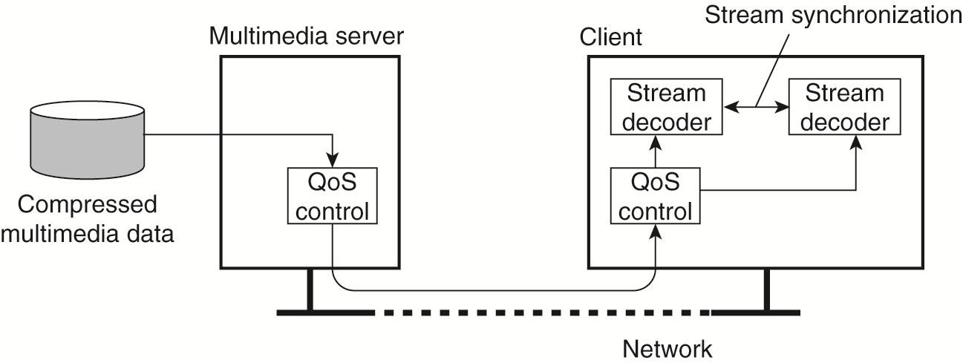
Streaming Stored Data
A general architecture for streaming stored multimedia data over a network

Slide 54


Streaming Stored Multimedia: What is it?
Cumulative data
2. video
sent
1. video
recorded
3. video received,
played out at client
network
delay
time
streaming: at this time, client
playing out early part of video,
while server still sending later
part of video

Slide 55
Delay Jitter
constant bit
rate
transmission
client
reception
constant bit
rate playout
at client
Cumulative data
variable
network
delay
(jitter)
buffered
data
client playout
delay
time
consider end-to-end delays of two consecutive packets: difference can be more or less than 20 msec (transmission time difference)

Slide 56
Streams and Quality of Service (QoS)
Timing and other nonfunctional requirements are generally expressed as QoS requirements.
QoS for continuous data streams mainly concerns timeliness, volume and reliability.
How do you specify QoS? A few important properties:
The required bit rate at which data should be transported.
The maximum delay until a session has been set up (i.e., when an application can start sending data).
The maximum end-to-end delay (i.e., how long it will take until a data unit makes it to a recipient).
The maximum delay variance, or jitter.
The maximum round-trip delay.

Slide 57
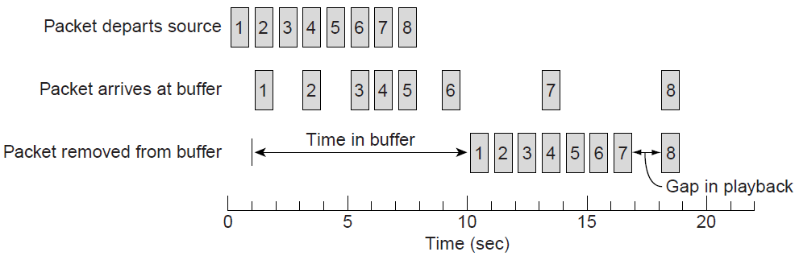
Enforcing QoS
Given the underlying system offers only a best-effort delivery service, DS try to conceal the lack of QoS
There are various network-level mechanisms,
such as differentiated services by which certain packets can be prioritized.
Another technique: Use buffers to reduce jitter:
Solution to packet loss: Increase the buffer size

Slide 58
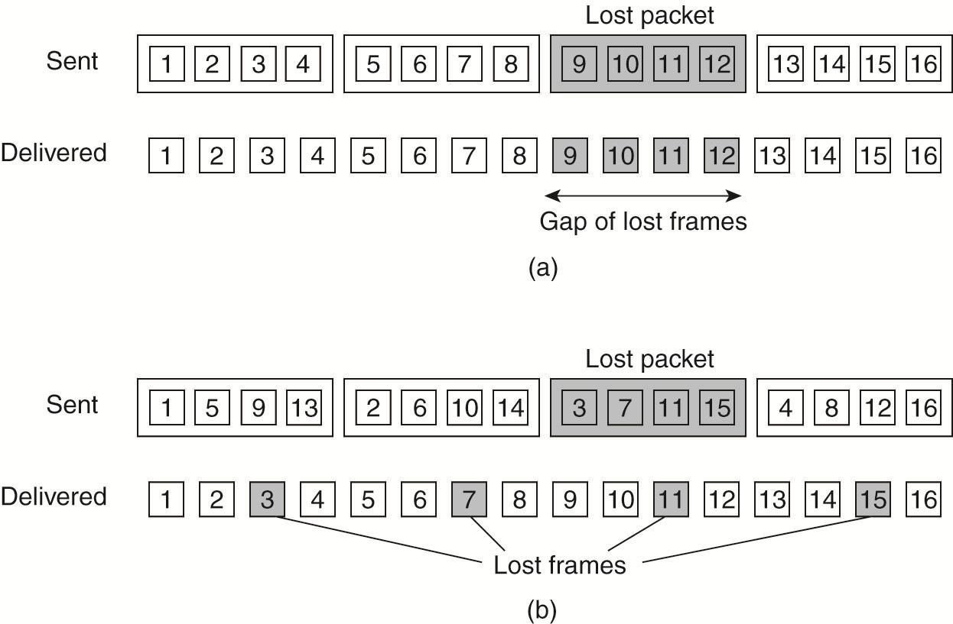
Enforcing QoS (continue…)
Problem: How to reduce the effects of packet loss (when multiple samples are in a single packet)?
Answer: Circumvented by interleaving frame
The effect of packet loss in (a) non-interleaved transmission and (b) interleaved transmission.
The resulting gap in successive frames is distributed over time
The approach requires a larger receive buffer and imposes a higher start delay

Slide 59
Stream Synchronization
Different streams, possibly in the form of a complex stream, need to be mutually synchronized.
Synchronization of streams deals with maintaining temporal relations between streams.
Two types of synchronization
Simplest form: synchronization between a discrete data stream and a continuous data stream
E.g., slide show enhanced with audio
More demanding type: synchronization between continuous data streams
E.g., movie (1 video + 2 audio lip synchronization)

Slide 60
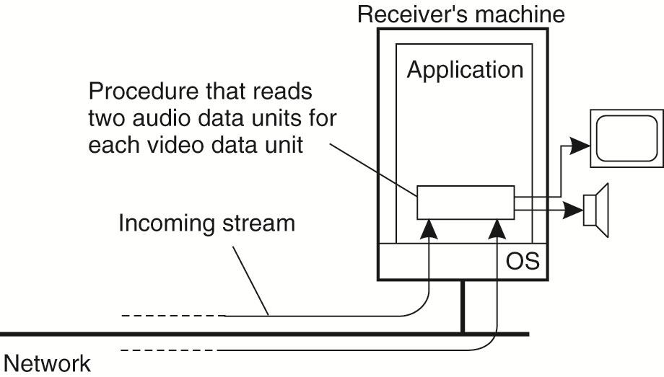
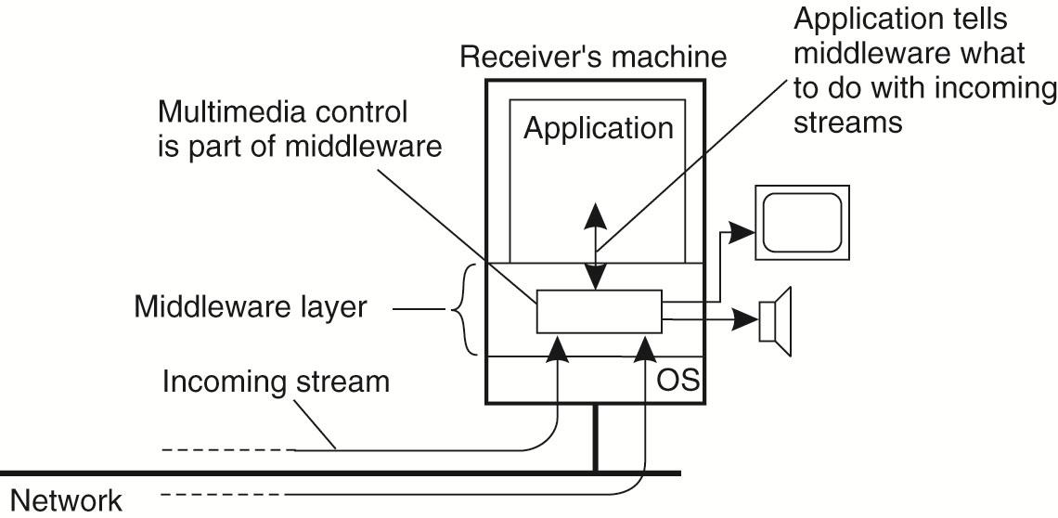
Synchronization Mechanisms (1)
The basic mechanisms for synchronizing two streams, which can be viewed at several different levels of abstraction
The principle of explicit synchronization on the level data units
The principle of synchronization as supported by high-level interface

Slide 61
Synchronization Mechanisms (2)
2. The distribution of those mechanisms in a networked environment
Common practice:
Multiplex all substreams into a single stream, and demultiplex at the receiver. Synchronization is handled at multiplexing/demultiplexing point (MPEG).
Delays for all channels are now identical

Slide 62
Unit 4 – Communication: Outline
Fundamentals
Layered Protocols
Types of Communication
Remote Procedure Call (RPC)
Message-Oriented Communication
Stream-Oriented Communication
Multicast Communication
Summary
Four high-level middleware communication service
Notes:
Interprocess communication is at the heart of all distributed systems. It makes
no sense to study distributed systems without carefully examining the ways that
processes on different machines can exchange information. Communication in
distributed systems is always based on low-level message passing as offered by
the underlying network. Expressing communication through message passing is
harder than using primitives based on shared memory, as available for nondistributed
platforms. Modem distributed systems often consist of thousands or even
millions of processes scattered across a network with unreliable communication
such as the Internet.
In this chapter, we start by discussing the rules that communicating processes
must adhere to, known as protocols, and concentrate on structuring those protocols
in the form of layers. We then look at three widely-used models for communication:
Remote Procedure Call (RPC), Message-Oriented Middleware (MOM),
and data streaming. We also discuss the general problem of sending data to multiple
receivers, called multicasting.

Slide 63
Multicast Communication
Belong to the domain of network protocol for many years, where numerous proposals for network-level and transport-level solutions have been implemented and evaluated
Major issue: set up the communication paths for information dissemination
With the advent of P2P technology and structured overlay management, it became easier to set up explicit communication paths.
As peer-to-peer solutions are typically deployed at the application layer, various application-level multicasting techniques have been introduced.
Alternative way: Gossip-based information dissemination (simple but less efficient)

Slide 64
Application-Level Multicasting (ALM)
Basic idea: nodes organize into an overlay network, which is then used to disseminate information to its members
Important observation: network routers are not involved in group membership
Consequence:
the connections between nodes in the overlay network may cross several physical links
routing messages within the overlay may not be optimal in comparison to what could have been achieved by network-level routing

Slide 65
Overlay construction
Two approaches:
Nodes organize themselves directly into a tree  there is a unique (overlay) path between every pair of nodes
Nodes organize into a mesh network in which every node will have multiple neighbours and, in general, there exist multiple paths between every pair of nodes
Main difference: the second approach provides higher robustness

Slide 66
Chord-based tree building
Assume a node wants to start a multicast session:
Initiator generates a multicast identifier mid.
Lookup succ(mid), the node responsible for mid.
Request is routed to succ(mid), which will become the root.
If P wants to join, it sends a join request, LOOKUP(mid), to the root.
When request arrives at Q, which is any node on the path from P to the root:
Q has not seen a join request before  it becomes forwarder; P becomes child of Q. Join request continues to be forwarded.
Q knows about tree  P becomes child of Q. No need to forward join request anymore.

Slide 67
Overlay Construction
Observation: although building a tree by itself is not that difficult once we have organized the nodes into an overlay, building an efficient tree may be a different story
The selection of nodes in the next slide does not take into account any performance metrics: it is purely based on the (logical) routing of messages through the overlay.
The quality of an ALM tree is generally measured by three different metrics:
link stress, stretch, and tree cost.

Slide 68
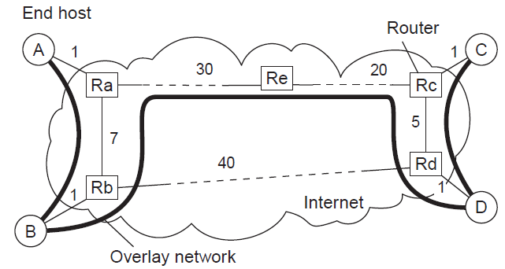
ALM: Some Costs
Root of a multicast tree
Link stress: How often does an ALM message cross the same physical link?
Example: message from A to D needs to cross〈R_{a}, R_{b}〉twice.
Stretch (Relative Delay Penalty, RDP): Ratio in delay between ALM-level path and network-level path. Example: messages B to C follow path of length 71 at ALM, but 47 at network level  stretch = 71/47.
Tree cost: a global metric, generally related to minimizing the aggregated link costs.

Slide 69
Gossip-Based Data Dissemination
An increasingly important technique for dissemination information is to rely on epidemic behavior.
Main goal of epidemic protocols: to rapidly propagate information among a large collection of nodes using only local information
Whereas health organizations try to prevent infectious diseases from spreading

Slide 70
Epidemic Algorithm: Principles
Basic idea
Assume there are no write–write conflicts:
Update operations are performed at a single server
A replica passes updated state to only a few neighbors
Update propagation is lazy, i.e., not immediate
Eventually, each update should reach every replica
Two forms of epidemics
Anti-entropy: Each replica regularly chooses another replica at random, and exchanges state differences, leading to identical states at both afterwards
Gossiping: A replica which has just been updated (i.e., has been contaminated), tells a number of other replicas about its update (contaminating them as well).

Slide 71
Unit 4 – Communication: Outline
Fundamentals
Layered Protocols
Types of Communication
Remote Procedure Call (RPC)
Message-Oriented Communication
Stream-Oriented Communication
Multicast Communication
Summary
Four high-level middleware communication service
Notes:
Interprocess communication is at the heart of all distributed systems. It makes
no sense to study distributed systems without carefully examining the ways that
processes on different machines can exchange information. Communication in
distributed systems is always based on low-level message passing as offered by
the underlying network. Expressing communication through message passing is
harder than using primitives based on shared memory, as available for nondistributed
platforms. Modem distributed systems often consist of thousands or even
millions of processes scattered across a network with unreliable communication
such as the Internet.
In this chapter, we start by discussing the rules that communicating processes
must adhere to, known as protocols, and concentrate on structuring those protocols
in the form of layers. We then look at three widely-used models for communication:
Remote Procedure Call (RPC), Message-Oriented Middleware (MOM),
and data streaming. We also discuss the general problem of sending data to multiple
receivers, called multicasting.

Slide 72
Summary
An important issue in middleware systems is to offer a higher level of abstraction that will make it easier to express communication between processes than the support offered by the interface to the transport layer.
RPCs, offering synchronous communication facilities, have been widely adopted as the basis of middleware and distributed systems in general.
In message-oriented models, the issues are whether or not communication is persistent, and whether or not communication is synchronous.
Streaming communication addresses whether or not two successive messages have a temporal relationship.
Two approaches in multicasting communication:
Building a tree
Deploying epidemic protocols

Slide 73
Seminar Topics
RPC
https://en.wikipedia.org/wiki/Remote_procedure_call
Gossip protocol
https://en.wikipedia.org/wiki/Gossip_protocol
Patrick T. Eugster, et al., “Epidemic Information Dissemination in Distributed Systems”, IEEE Computer, (37)5:60-67, May 2004.
IBM’s WebSphere Message-Queuing System
https://en.wikipedia.org/wiki/IBM_WebSphere_MQ
https://www.ibm.com/support/knowledgecenter/en/SSFKSJ_7.5.0/com.ibm.mq.pro.doc/q002620_.htm
https://www.ibm.com/support/knowledgecenter/SSFKSJ_7.5.0/com.ibm.mq.pro.doc/q002640_.htm

Slide 74
Seminar Topics (cont.)
5. Publish/Subscribe pattern
https://en.wikipedia.org/wiki/Publish%E2%80%93subscribe_pattern
6. Publish/Subscribe networks
https://www.ibm.com/support/knowledgecenter/en/SSFKSJ_9.0.0/com.ibm.mq.pro.doc/q005120_.htm
Application of virtual machines to distributed systems
E.g., virtualization in cloud computing

